Slide 1


Deep2Neuron Tech Academy
Internship 2023
Convolutional Neural Networks
A. CHINRAJ
June 26, 2023

Slide 2
Contents
Introduction
Convolutional Layer
Activation Layer
Pooling Layer
Flattening
Fully Connected Layer
Backpropagation
Pretrained Model
CNN Architecture
Applications

Slide 3
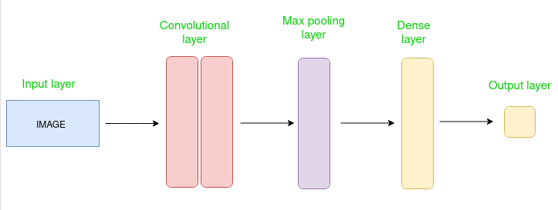


Introduction
Convolutional Neural Networks
Deep learning algorithm
Designed for analyzing visual data
Capture local pattern and spatial dependencies within data
Building blocks : Convolutional layers – extract features

Slide 4
Convolutional Layer
Extract features from the dataset
Applies set of learnable filters – kernels
Filters – usually smaller matrices of 2x2, 3x3, or 5x5 shape
Slide over input layer
Dot product between kernel weight and corresponding input image patch
Output – Feature maps
Let convolutional layer have 12 filters then,
Output volume dimension : 32x32x12

Slide 5
Activation Layer
Activation function
Add non-linearity to the network
Common - ReLU: max(0,x)
Tanh
Leaky ReLU
Allow network to learn complex representations
Volume remains unchanged

Slide 6
Pooling Layer
Periodically inserted in the covnets
Main function : Reduce volume size
Make computation fast, prevent overfitting
Common types
Max Pooling
Average Pooling
Let max pool with 2x2 filters and stride 2,
Resultant volume dimension: 16x16x2

Slide 7
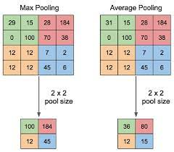

Slide 8
Flattening
Resulting feature maps are flattened
One-dimensional vector after convolution and pooling
As it can be passed to completely linked layer
For categorization or regression

Slide 9
Fully Connected Layer
Connect every neuron of one layer to
Every neuron in the next layer
Used for classification and regression tasks
Providing high-level reasoning,
Based on the extracted features

Slide 10
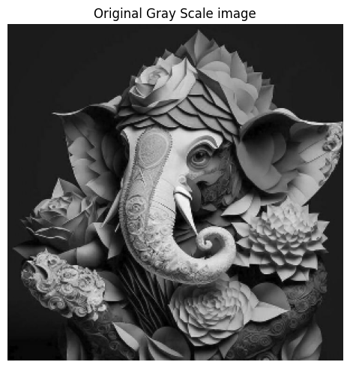


Input
Original Greyscale Image

Slide 11
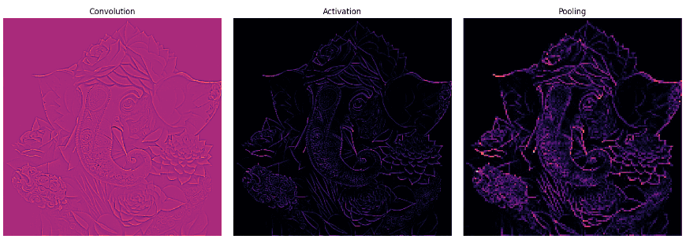

Convolution
Activation
Pooling

Slide 12
Backpropagation
Used for training CNN
Adjusting weights of network,
based on the computed error or loss
Gradient of loss function is calculated,
w.r.t. network parameters
Weight updated using optimization algorithm
like SGD or its variants

Slide 13
Pretrained Models
Widely available and trained on large scale datasets,
such as ImageNet
Learned rich feature representations
Used as starting point for various computer tasks
Common technique – Transfer Learning
where pretrained model are fine-turned on
specific tasks with smaller labeled dataset

Slide 14
CNN Architecture
VGG
Xception
ResNet
DenseNet
InceptionV3
InceptionResnet
MobileNet
NasNet
EfficientNet
ConvNeXt

Slide 15
Applications
Image Classification
Object Detection
Sematic Segmentation
Image Generation
Video Analysis

Slide 16
Thank you

